Slide 1
Mushroom Classification Project

Slide 2
Objective:
Development of a predictive model for classifying mushrooms as either edible or poisonous based on their features. The model will determine whether a given mushroom is safe to consume or not.
Benefits:
1. Identification of poisonous mushrooms: The model can help in detecting potentially harmful mushrooms and prevent incidents of poisoning.
2. Improved safety for mushroom enthusiasts: The classification model can provide valuable information to mushroom collectors and enthusiasts, enabling them to make informed decisions about the mushrooms they encounter

Slide 3
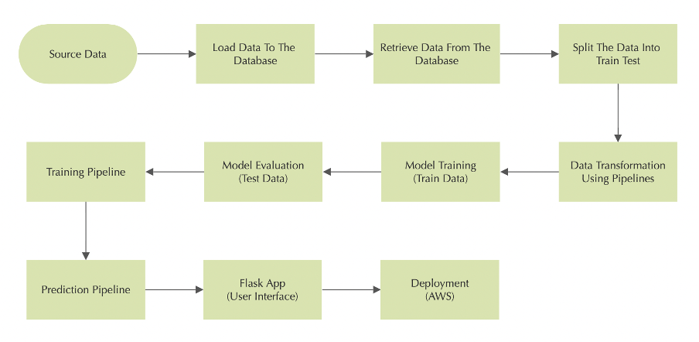
Architecture

Slide 4

Load Data
Connected the Mongodb database
We read source csv file and loaded the data into the Mongodb database
Read the data from the database and converted to raw.csv for further data split process

Slide 5
Data Ingestion
Read raw.csv and it was split into train and test data using Scikit Learn
The Split data then created as train.csv and test.csv
Returned path of the train.csv and test.csv for further step

Slide 6
Exploratoratory Data Analysis
Read the data using pandas and analyse the count of each variable using count plot
Checked the missing values and found some categories are missing and it was added as “?” in the data.
Conducted Chi-Square test for all the columns to find the important feature and find the relation between the columns using cross tab.

Slide 7
Data Transformation :
Created preprocessing pipeline to follow imputation and transformation for all the categorical columns using simple imputer and Ordinal Encoding techniques
Passed train and test columns separately to column transformer. It was transformed without any data leakage
Saved the preprocessor pickle which will help to transform the unseen data.
Returned transformed train and test array to further step

Slide 8
Model Training:
Transformed data is moved to model training.Training is conducted on train data.
Decision tree and Logistic Regression is used to train and validated the model on test data.
By using “F1 macro” metrics best model is found and saved as picked file which then can be used to predict the unseen data

Slide 9
Decision Tree Algorithm:
A decision tree algorithm is a versatile and widely-used machine learning technique for classification tasks. It builds a flowchart-like model that makes predictions based on feature values. The algorithm selects the best features for splitting the data, recursively creating branches and levels in the tree until a stopping condition is met. The resulting tree can be used to predict the outcome for new data points by following a path from the root to a leaf node.
Logistic regression Algorithm:
It is used for binary classification tasks. It is an extension of linear regression that predicts the probability of an event occurring. The algorithm estimates the relationship between the input features and the binary outcome by applying a logistic function, also known as the sigmoid function. This transformation maps the linear regression output to a probability value between 0 and 1. If the probability exceeds a certain threshold, typically 0.5, the data point is classified into the positive class; otherwise, it is classified into the negative class.

Slide 10
Prediction:
Created separate prediction pipeline to predict the unseen data. Model saved as picked file which then loaded. It is used to predict the unseen data based on the client input and displayed on the web
interface

Slide 11
Web User Interface
User Interface was created using Flask, HTLM and CSS. When the client entered the respective details on website. It passed to the prediction pipeline where it predicts type of mushroom either it is edible or poisonous with a probability of the classification. Web interface has home page and predict page. Home page has all the details of the mushroom to select. Once the predict button is used it will redirect to the predict page where it shows the result of the classification. Created train route which will train the model if train is updated.

Slide 12
Q & A:
Q1) What’s the source of data?
The data is available in Kaggle.
Q 2) What is the type of data?
The type of data is categorical.
Q 3) What’s the complete flow you followed in this Project?
Refer slide 3rd for better Understanding
Q 4) What’s the accuracy is achieved in this Project?
Achieved 100% accuracy by cross validating the 30 different types of sample from the training data

Slide 13
Q 5) How logs are managed?
We followed log at every step of the process Load data, Data ingestion, Data Transformation, Model Training and stored it is src/logger folder.
Q 6) What techniques were you using for data pre-processing?
Imputing missing values with mode using simple imputer
Converting categorical data into numeric values using Ordinal encoding.

Slide 14
Q 7) How training was done or what models were used?
Training conducted on train data using scikit-learn library which was transformed in previous steps
In web interface we created the training route where it runs model training in the background
Algorithms like decision tree and logistic regression were used.
Q 8) How Prediction was done?
Using data ingestion, test data was split before moving to further process to avoid data leakage. Once training was done, predictions was performed on the test data

Slide 15
Q 9) What are the different stages of deployment?
When the model is ready we pushed to Github.
Created environment in Elastic Beanstalk
Created CodePipeline using GitHub for continuous deployment

